Slide 1
Introduction to Arduino Microcontroller and Programming with an Arduino Microcontroller.
By Tahseen Asma Meem
Course Teacher: Prof. Dr. Engr. Muhibul Haque Bhuyan
Email: muhibulhb@aiub.edu
Cell # 01815-657346
Room # DN514

Slide 2
Example of a Microcontroller: ATmega328
ATmega-328 is basically an Advanced Virtual RISC (AVR) microcontroller. ATmega-328 has 32KB internal built-in memory.
ATmega328 supports the data up to eight (8) bits and 28 Pins AVR Microcontroller, manufactured by Microchip, follows RISC Architecture, and has a flash-type program memory of 32KB.
ATmega 328 has 1KB Electrically Erasable Programmable Read Only Memory (EEPROM). For an EEPROM, if the electric supply is removed from the microcontroller, it can store the data. After providing an electric supply it can provide previous results.
ATmega-328 has 2KB Static Random Access Memory (SRAM).
It has 8 Pin for ADC operations, which all combines to form Port A (PA0 – PA7).

Slide 3
Example of a Microcontroller: ATmega328
It also has 3 built-in Timers, two of them are 8 Bit timers while the third one is a 16-Bit Timer.
Arduino UNO is based on Atmega328 Microcontroller. It’s UNO’s heart.
It operates ranging from 3.3V to 5.5V but normally we use 5V as a standard.
Its excellent features include cost efficiency, low power dissipation, programming lock for security purposes, real timer counter with a separate oscillator.
It’s normally used in Embedded System applications.
Moreover, ATmega 328 has several different features which make it the most popular device in today’s market. These features consist of advanced RISC architecture, good performance, 6 PWM pins, programmable Serial USART, programming lock for software security, throughput up to 20 MIPS, etc.

Slide 4
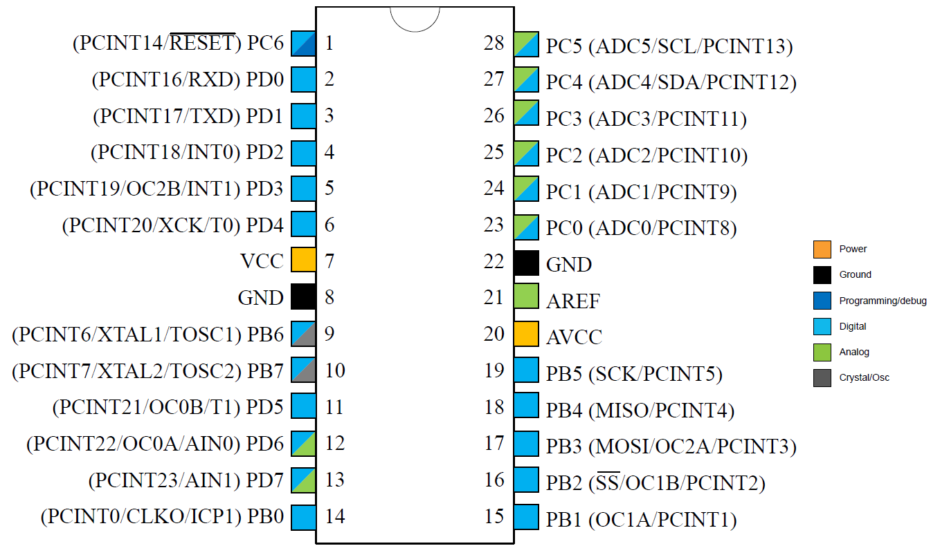
Pinouts of ATmega328P

Slide 5
ATmega328 Pins Description
The ATmega328P microcontroller has 28 pins (in DIP package) organized into three main 8-bit bidirectional I/O ports—Port B, Port C, and Port D—which feature internal pull-up resistors and specialized functions, including PWM, ADC, and communication interfaces. These ports are controlled by Data Direction (DDRx), Port (PORTx), and Pin Input (PINx) registers. Here is a detailed breakdown of the ATmega-328 ports:
Port B (PB0-PB7): An 8-bit bidirectional I/O port (pins 9-14, 16-17). Pins PB6/PB7 are used for the crystal oscillator (XTAL1/XTAL2). Special functions includes SPI pins (SS/PB2, MOSI/PB3, MISO/PB4, SCK/PB5) and PWM output (OC1A/PB1, OC1B/PB2, OC2A/PB3). Arduino Mapping: Pins 8-13 correspond to PORTB.
Port C (PC0-PC6): A 7-bit port (pins 23-28, plus PC6 on pin 1). Analog Inputs: Channels ADC0-ADC5 (PC0-PC5). I2C Interface: PC4 (SDA) and PC5 (SCL). Reset: PC6 acts as the RESET pin (active low).
Port D (PD0-PD7): An 8-bit bidirectional I/O port (pins 2-7, 11-12). Serial Communication: PD0 (RXD) and PD1 (TXD). External Interrupts: PD2 (INT0) and PD3 (INT1). PWM/Analog: Includes PWM outputs (PD3, PD5, PD6). Arduino Mapping: Pins 0-7 correspond to PORTD.
Key Power and Reference Pins:
VCC & GND: Digital Power (2.7-5.5 V) and Ground.
AVCC: Supply voltage for the Analog-to-Digital Converter.
AREF: Analog reference pin for the ADC.

Slide 6
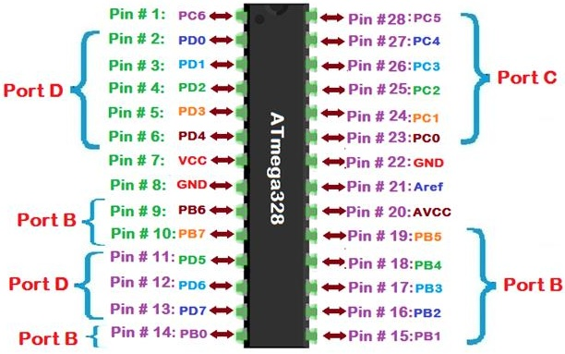
Various ports of ATmega328P

Slide 7
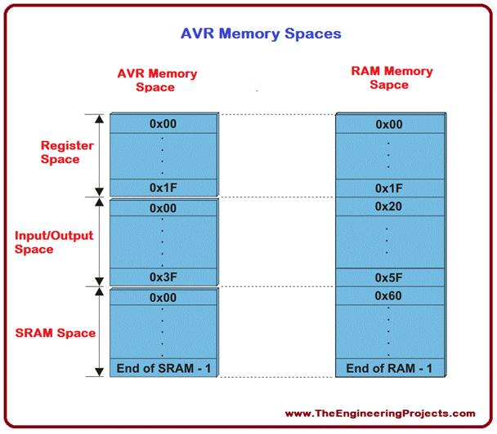
ATmega328 Memory
ATmega 328 has three types of memories e.g., EEPROM, SRAM, etc. The capacity of each memory is explained in detail below:
Flash Memory has 32KB capacity. It has an address of 15 bits. It is a Programmable Read Only Memory (ROM) and non-volatile memory.
SRAM stands for Static Random Access Memory. It is a volatile memory, i.e., data will be removed after removing the power supply.
EEPROM stands for Electrically Erasable Programmable Read Only Memory. It has long-term data.

Slide 8
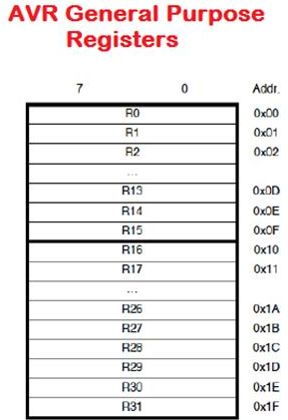
ATmega328 General Purpose Registers
ATmega-328 has thirty-two (32) General Purpose Registers (GPRs).
These all of the registers are part of Static Random Access Memory (SRAM).

Slide 9
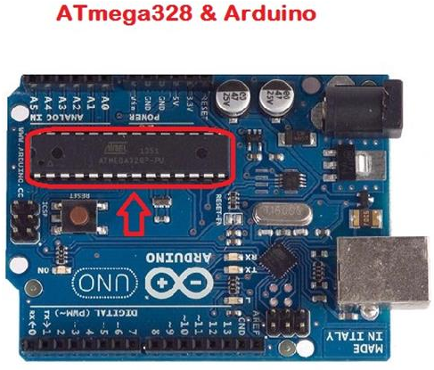
ATmega328 and Arduino
ATmega-328 is the most important microcontroller that is used while designing.
ATmega 328 is the most important part of Arduino.
The program is uploaded on the AVR microcontroller attached to Arduino.
Analog In/Outputs
Digital In/Outputs

Slide 10
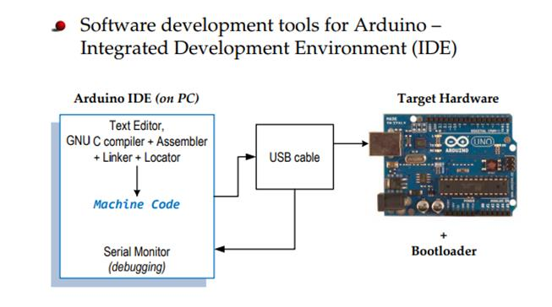

Slide 11
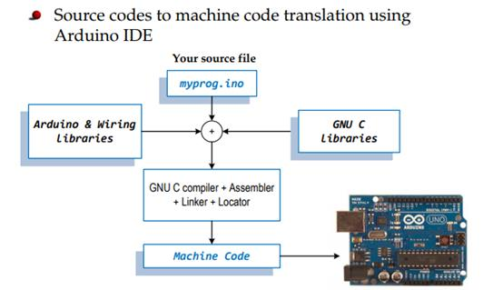

Slide 12
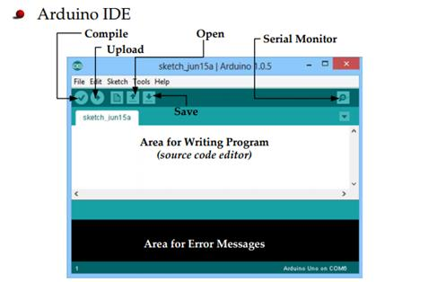

Slide 13
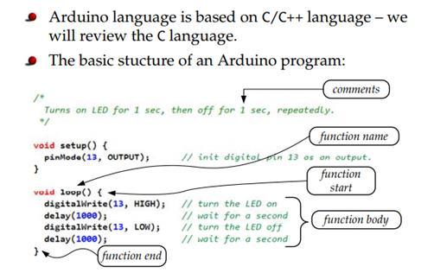

Slide 14
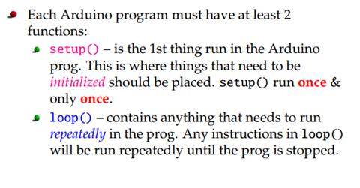

Slide 15
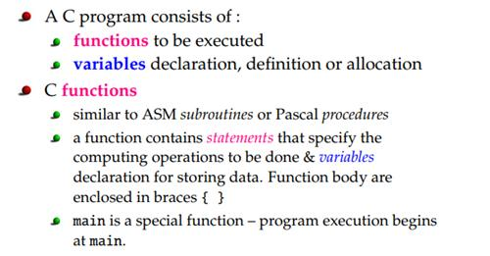

Slide 16
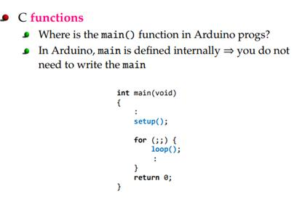
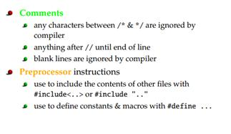

Slide 17
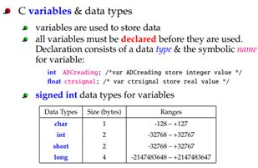
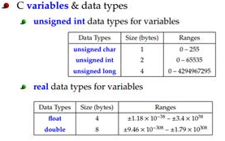

Slide 18
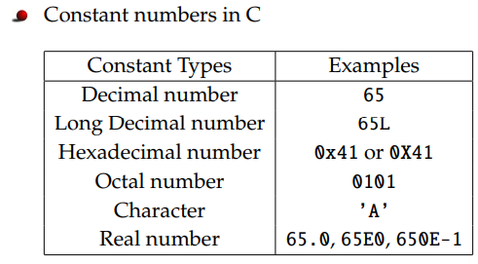
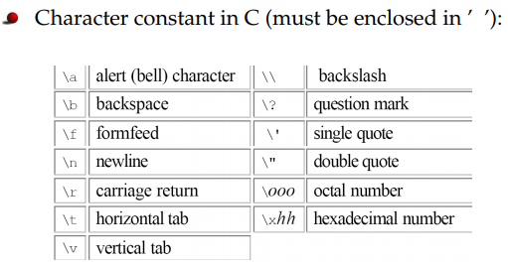

Slide 19
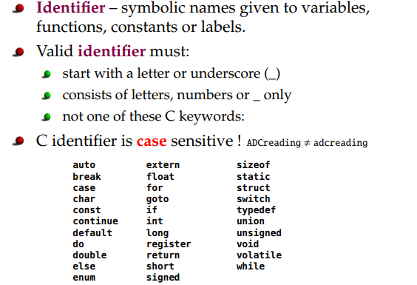

Slide 20
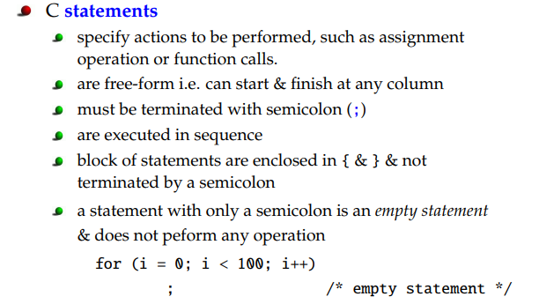

Slide 21
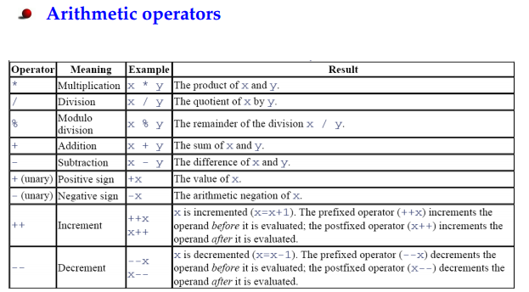
A Brief Overview of C/C++ Language

Slide 22
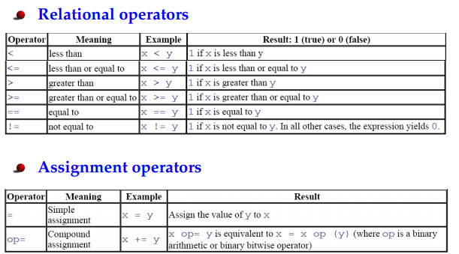
A Brief Overview of C/C++ Language

Slide 23
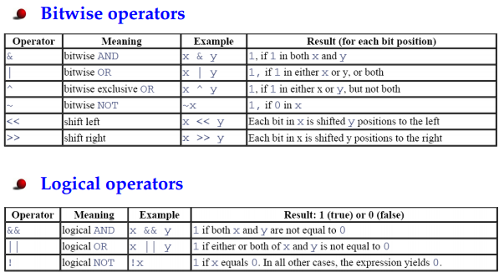
A Brief Overview of C/C++ Language

Slide 24
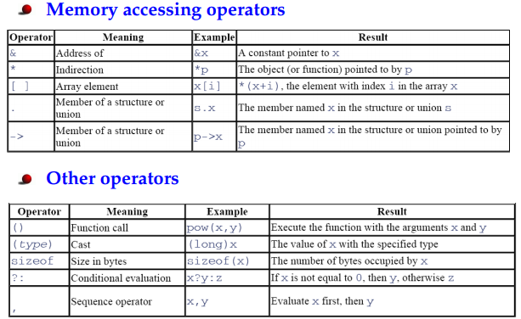
A Brief Overview of C/C++ Language

Slide 25
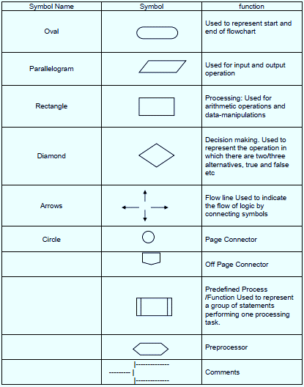
A Brief Overview of C/C++ Language
While creating a flowchart, the following commonly used symbols in the flowchart
are used.
Rectangle Shape - Represents a process
Oval or Pill Shape - Represents the start or end
Diamond Shape - Represents a decision
Parallelogram - Represents input/output
Circle - Represents reference/page connector
Arrow - Represents a connection between shapes

Slide 26
Commonly used Symbols in Flowchart
Each symbol has its own function within the program. Each symbol represents a piece of the code written for the program. The start/end symbol can be used to represent either the beginning or ending of a program. The symbol for process allows you to show how the program is functioning, like when you need the program to calculate two numbers or even analyze the information.
When you decide to enter data, show it on the screen, or print it to paper, you use the input/output symbol. The display symbol signifies that information is displayed to the user.
There are many other symbols frequently used in flowcharts. The decision symbol is used for things like 'if statements,' where you must choose an option based on a specified criteria. A decision question may be something as simple as: if the grade is at least 70 then send out the message 'Passing' to the screen. Otherwise, send 'Failing' to the screen.

Slide 27
Draw a flowchart along with its algorithm to add two numbers entered by the user.
Example # 1 of Flowchart
An algorithm to find the sum of two numbers:
Step 1: Start
Step 2: Declare three variables
Step 3: Read numbers and store them in the declared variables
Step 4: Sum these two numbers and assign them to the declared variable
Step 5: Display the sum
Step 6: Stop

Slide 28
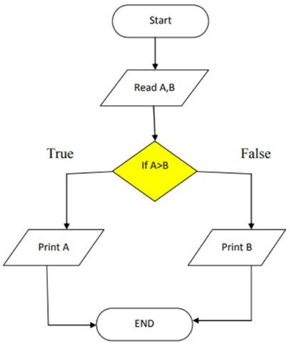
Draw a flowchart along with its algorithm to compare two numbers entered by the user and then find the greater number among the given two.
Example # 2 of Flowchart
The algorithm is given below:
Step 1: Start
Step 2: Read two numbers and store them in the two variables, A and B
Step 3: If A > B then Display A else Display B
Step 4: Stop

Slide 29
Draw a flowchart along with its algorithm to convert temperature from Celsius to Fahrenheit.
Example # 4 of Flowchart
Step 1: Start
Step 2: Declare two variables
Step 3: Read the temperature value in Celsius scale and store it in one of the declared variables
Step 4: Apply the formula of temperature conversion i.e., F = (9*C)/5 + 32 to the convert Celsius value in Fahrenheit scale and store it in the declared variable
Step 5: Display the temperature in Fahrenheit scale
Step 6: Stop

Slide 30
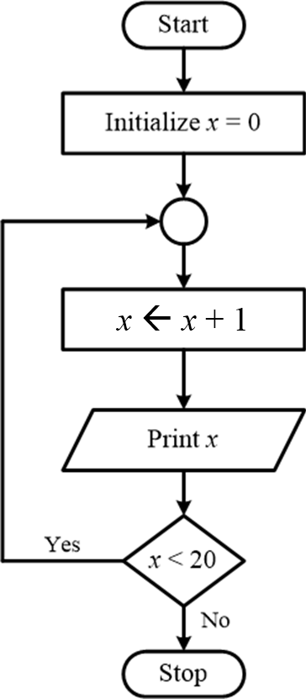
Draw a flowchart along with its algorithm to print numbers from 1 to 20.
Example # 5 of Flowchart
Step 1: Start
Step 2: Declare and initialize a variable with a 0 value
Step 3: Increment the variable value by 1 and store it in the same declared variable
Step 4: Print the value stored in the variable
Step 5: If the variable is < 20 then go to step 3, otherwise go to the next step
Step 6: Stop

Slide 31
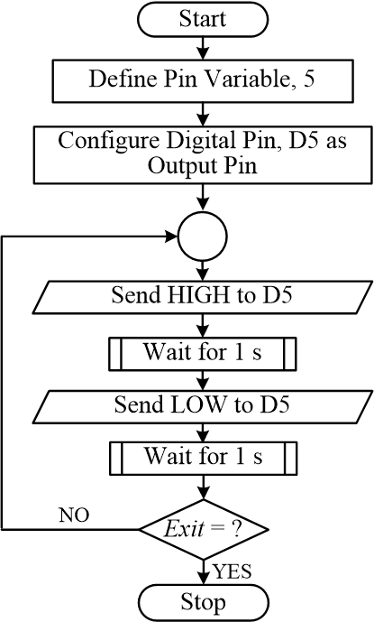
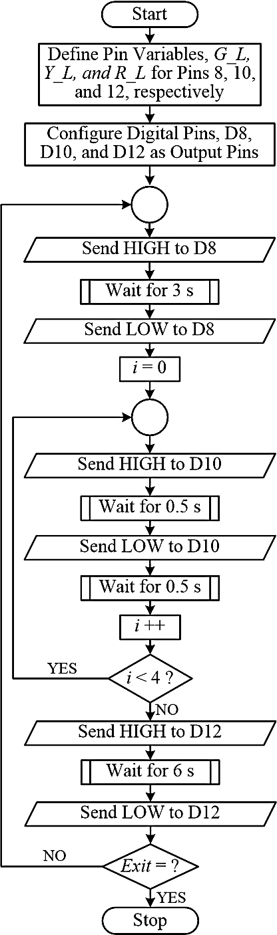
Experiment # 1’s Program Flowchart
Flowchart of the LED blink program
Flowchart of the traffic light control program

Slide 32
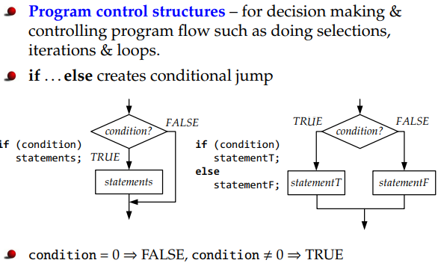
A Brief Overview of C/C++ Language

Slide 33
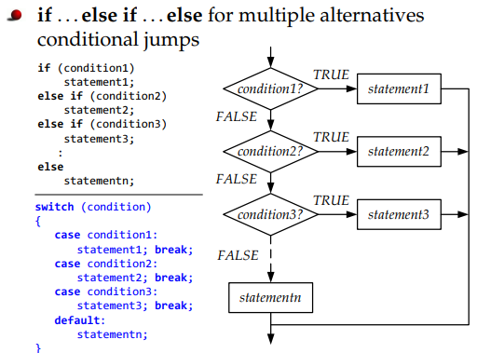
A Brief Overview of C/C++ Language

Slide 34
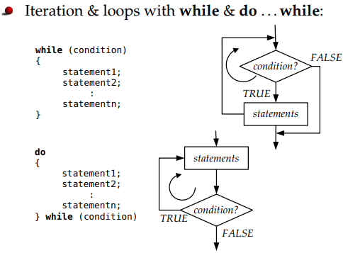
A Brief Overview of C/C++ Language
Draw a flowchart to print numbers from 1 to 20.

Slide 35
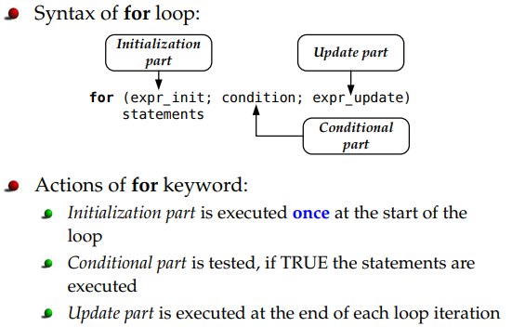
A Brief Overview of C/C++ Language

Slide 36
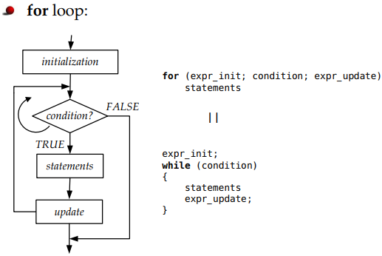
A Brief Overview of C/C++ Language

Slide 37
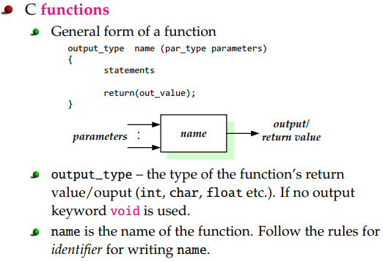
A Brief Overview of C/C++ Language

Slide 38
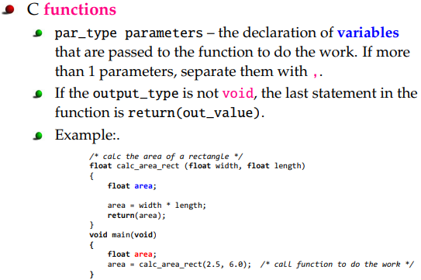
A Brief Overview of C/C++ Language

Slide 39
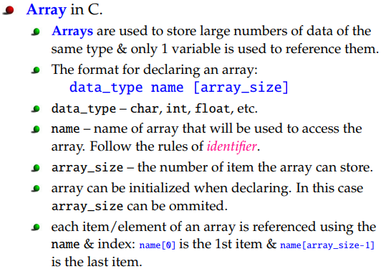
A Brief Overview of C/C++ Language

Slide 40
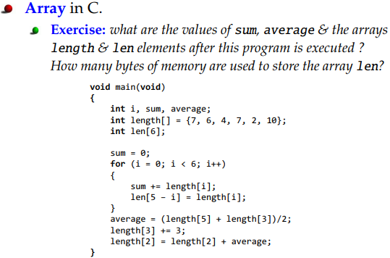
A Brief Overview of C/C++ Language

Slide 41
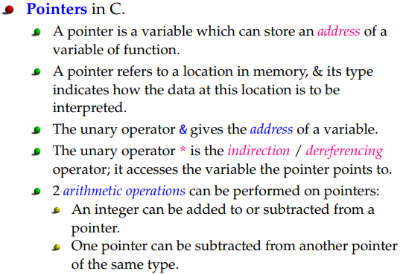
A Brief Overview of C/C++ Language

Slide 42
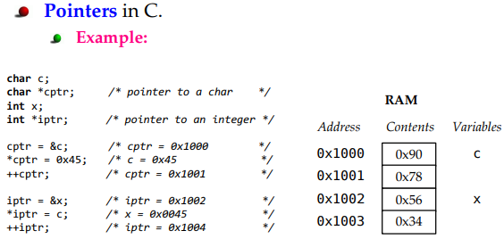
A Brief Overview of C/C++ Language

Slide 43
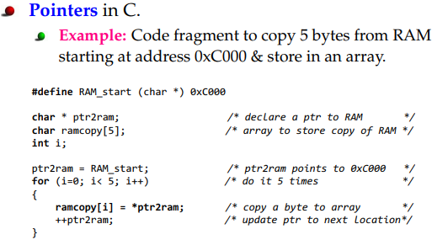
A Brief Overview of C/C++ Language

Slide 44
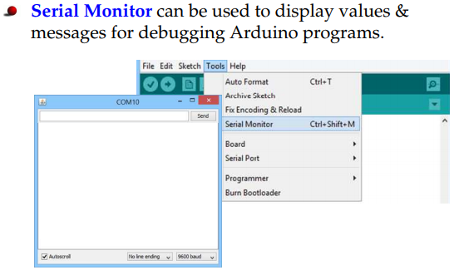
Data Display on Serial Monitor

Slide 45
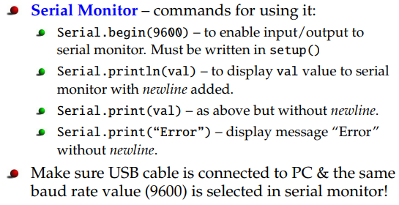
Data Transmission over Serial Channel

Slide 46
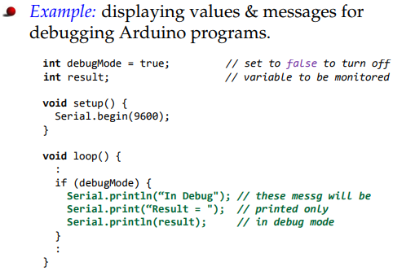
Data Transmission over Serial Channel

Slide 47
References
http://www.circuitstoday.com/arduino-uno-pinout-schematics
https://www.arduino.cc/.
https://www.coursera.org/learn/arduino/lecture/ei4ni/1-10-first-glance-at-a-program.
Jeremy Blum; Exploring Arduino: Tools and Techniques for Engineering Wizardry.
https://docs.arduino.cc/built-in-examples/basics/Blink/
https://www.tutorialspoint.com/arduino/arduino_blinking_led.htm
https://www.youtube.com/watch?v=FKekzzj5844

Slide 48
Thanks for attending….
?

